Slide 1
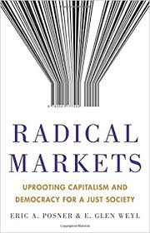
CS1501 Introduction to Blockchain

Slide 2
Intro to Blockchain Curriculum
Week 1: Incentive Loops and High-Level Blockchain Properties
Week 2: Hash Functions, Merkle Trees, and the Byzantine Generals Problem
Week 3: Guest Lecture by Josh Cincinnati on Bitcoin’s Proof of Work
Week 4: Redefining Permissionless for Proof of Stake Blockchains
Week 5: Guest Lecture by Glen Weyl on RadicalxMarkets
Week 6: Reviewing Cryptographic Primitives to Understand L2 Scaling
Week 7: Introduction to Radical Markets
Week 8: Fork Choice Rules for Proof of Work vs Proof of Stake
Week 9: Fundamental Tradeoffs (Decentralizations, Scalability, Privacy/Security)
Week 10: L1 Scaling (Sharding
Last Few Weeks: TBD (maybe a privacy lecture by Josh Cincinnati of ZCash)

Slide 3
10/12/2018 Roadmap
Assumptions
Wealth Staking
IDENTITY
Quadratic Voting
Harberger Tax
Liberal Radicalism

Slide 4
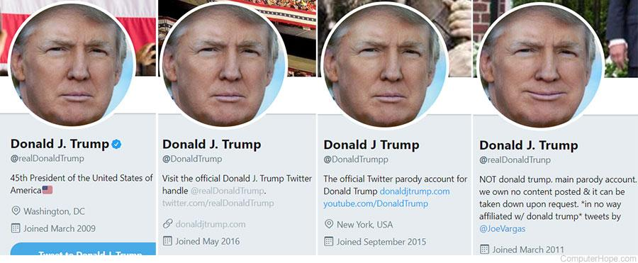
Proof of Stake (review)
Attach cost to vote in the form of COLLATERAL
Anti-Sybil Mechanism ⇔ Staking Capital (cost is locked up capital)
Difficulties:
Node Scalability (message overhead) of BFT
Dynamic Validator Set and Resistance to Long-Range Attacks
Is this even really Permissionless? Are we just renting identity?

Slide 5
Any risks associated with Voting on Blockchain?
Tree Falls in Forest Analogy only works if we don’t have...
→ Speaker/Listener Fault Equivalence
So, how do we guarantee censorship resistance?
→ Proof of Work vs Proof of Stake? Which is better?

Slide 6

Review: Micropayment Subscription Models
→ Blockchain changes transaction structure => New Market Designs
→ Review of Micropayment Subscription Models
→ Cultural Hurdles (convenience of bulk payments)

Slide 7


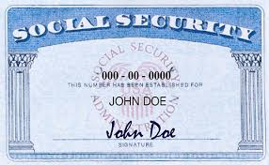
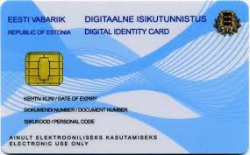
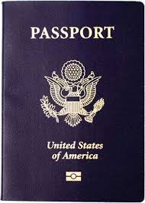
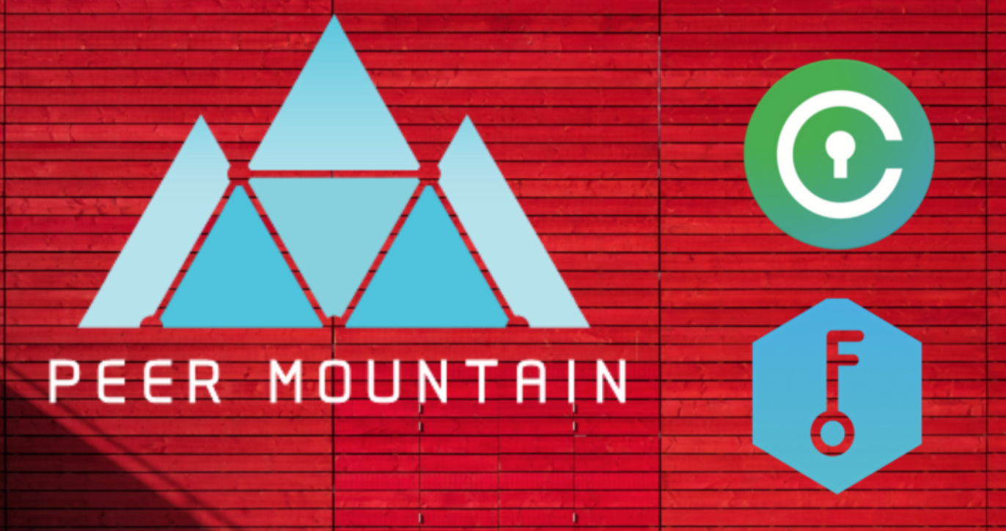
Other Blockchain Use Case: Identity

Slide 8
Tyranny of the Majority
→ Majority Rule does not achieve NET SOCIAL BENEFIT
→ Weak Utilitarianism

Slide 9
Quadratic Voting
→ QV enables group of people can use to jointly choose a collective good for themselves.
→ Each person can buy votes for or against a proposal by paying into a fund the square of the number of votes that he or she buys.
→ WHY QUADRATIC?

Slide 10
Harberger Taxes
→ Continuous Auction (present vision of world without property)
→ Allocative Efficiency vs Investment Efficiency
→ Applications: Domain Squatting, Unused Real Estate and similar illiquid assets
→ What goods does this NOT work for?

Slide 11
Liberal Radicalism
→ public fund matching mechanism (proportional to number of individuals that vote for a cause)
→ identity is assumed as well as a robust, trustless transaction system
Individuals make public goods contributions to projects of value to them. The amount received by the project is (proportional to) the square of the sum of the square roots of contributions received. Under the “standard model” this yields first-best public goods provision. Variations can limit the cost, help protect against collusion and aid coordination.
→ How does this incentivize coordination? Collusion risks?
→ Funding this with Harberger Taxes
→ Related Projects and People
→ SimonDLR and NFTs
→ Harberger Taxes Ad Board Implementation for ETHSF

